Slide 1
Cobalt- 60 Transportation WNA Meeting – Singapore 2013 April 8 - 9
Paul Gray; Chairman, ISSPA ;
V.P. External Relationships and Logistics, Nordion Inc.

Slide 2
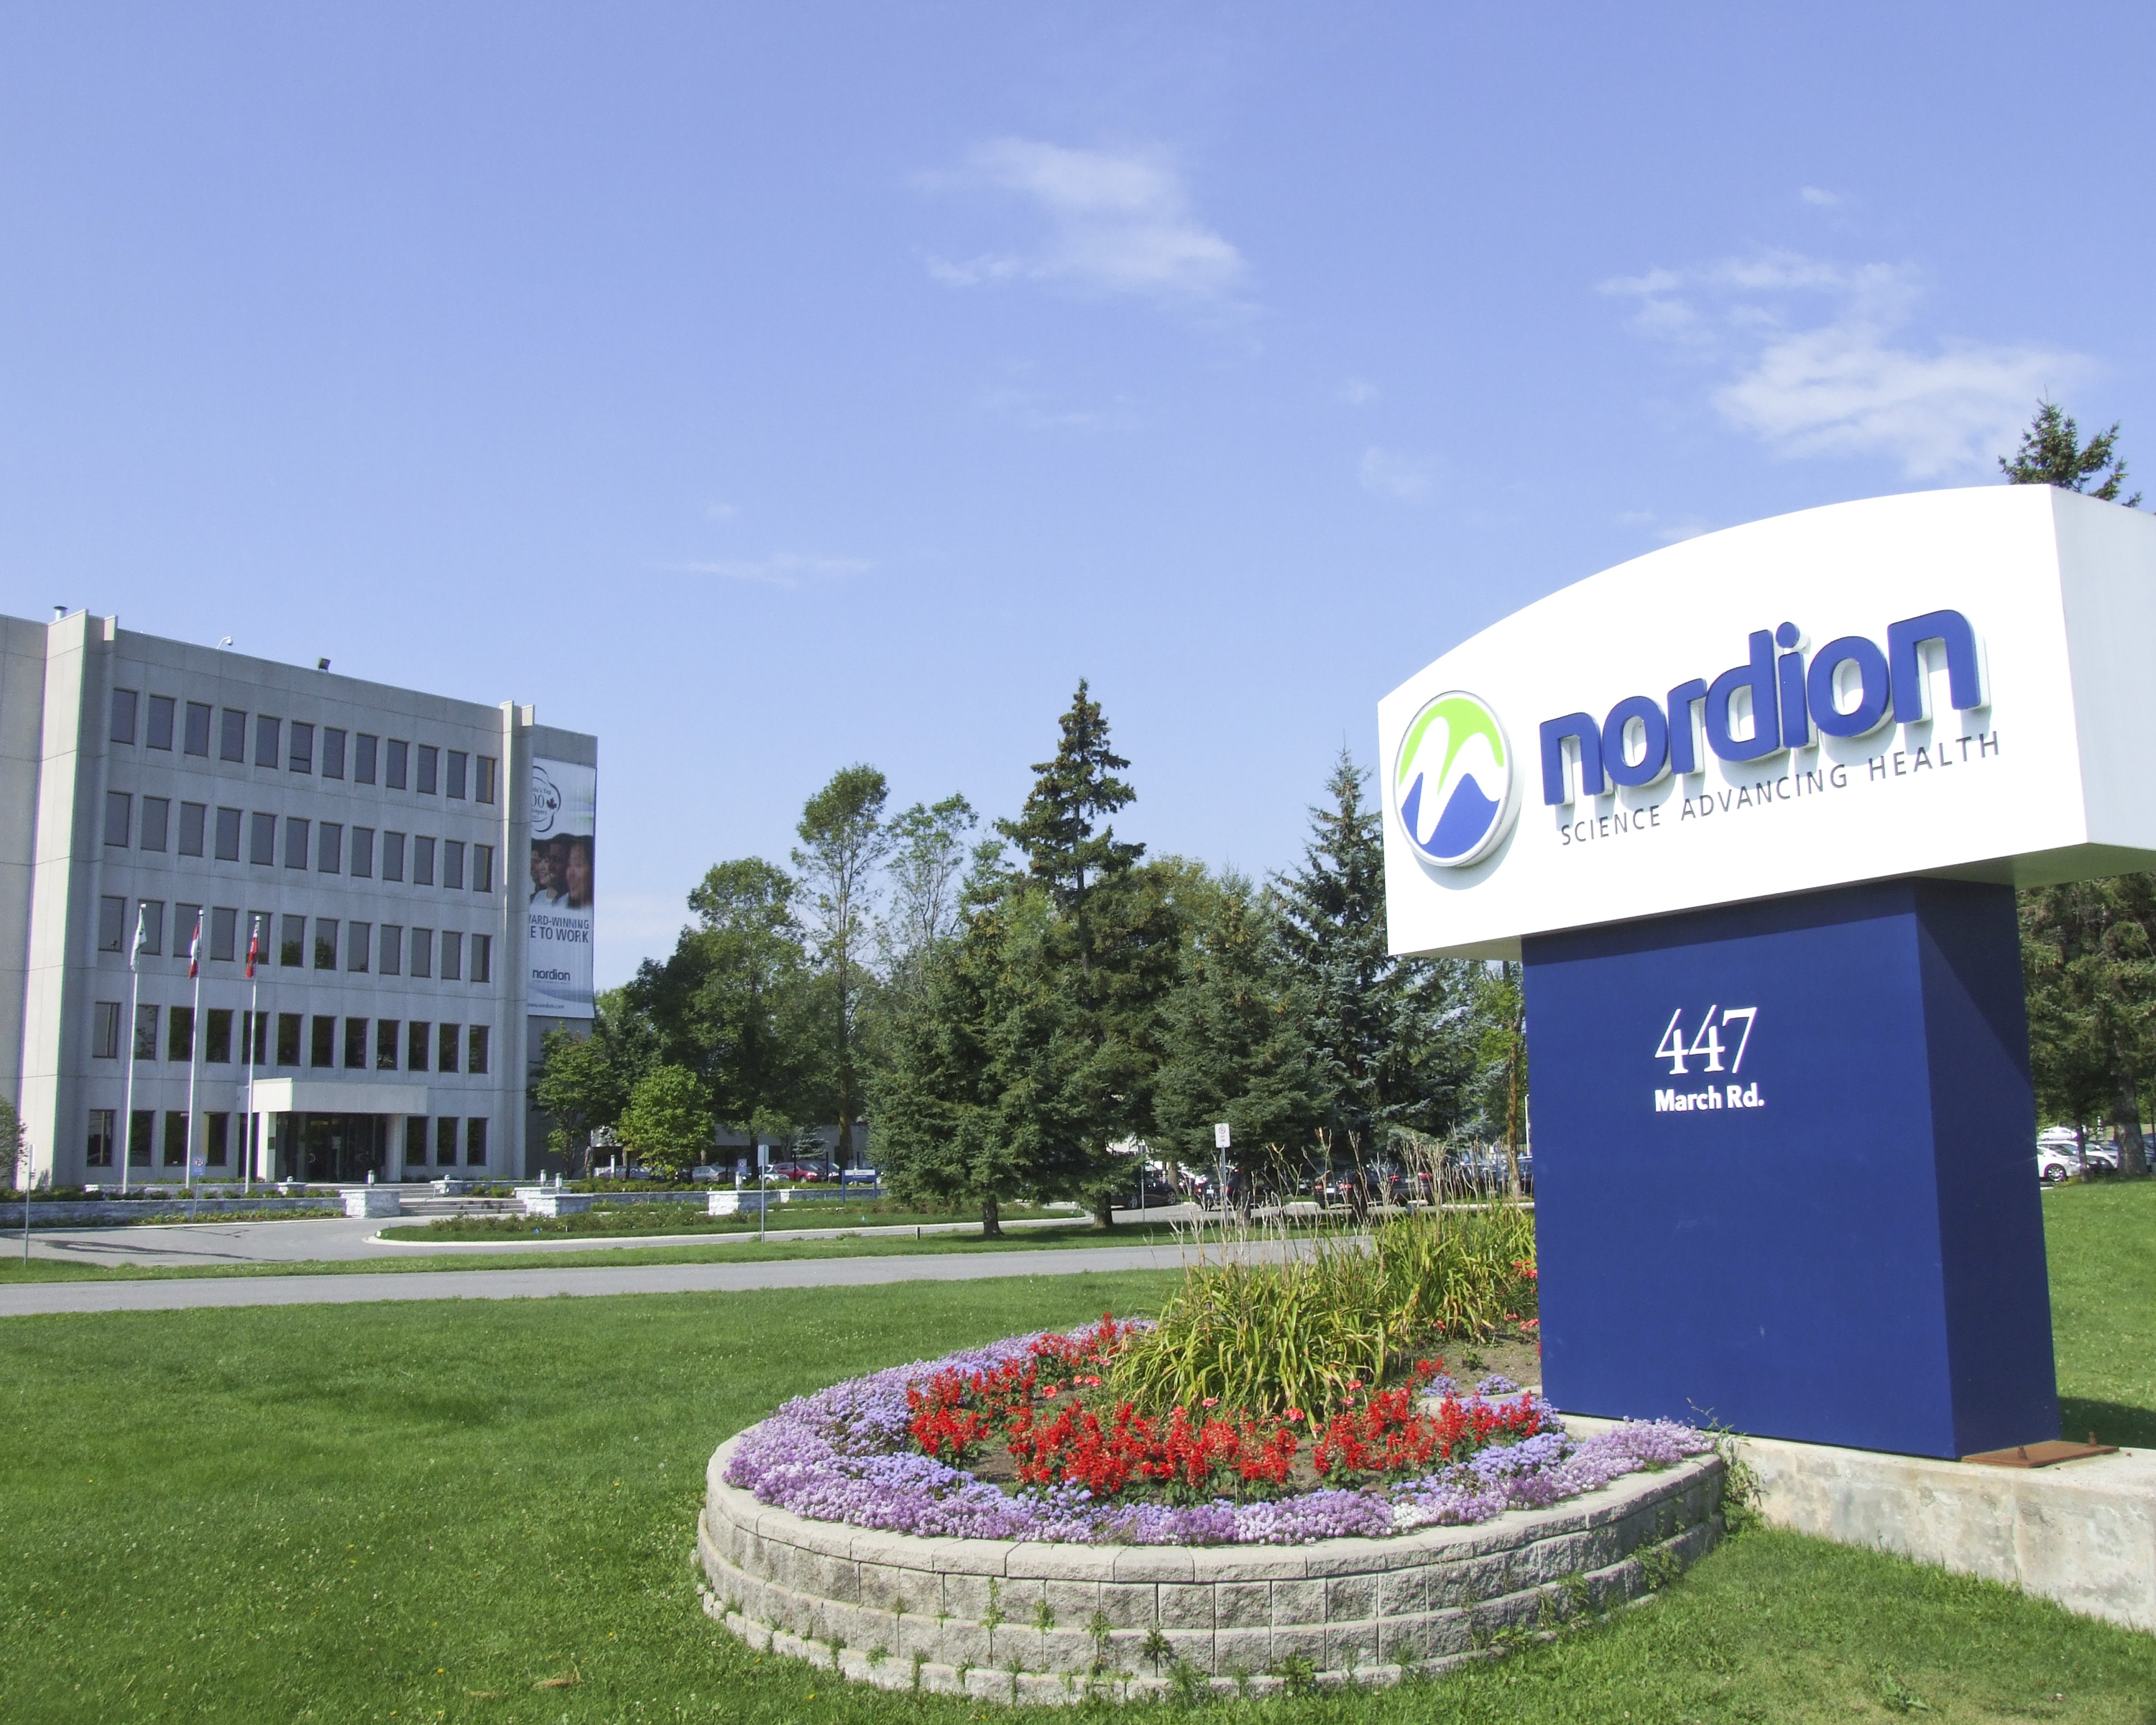
Nordion Inc.
Based in Ottawa, Canada. World’s leading supplier of Cobalt-60 for more than 50 years.
Recognized as a global authority in the design, manufacture and shipment of Cobalt-60 and Cobalt-60 transport containers
Regularly work with national and international (i.e. IAEA, IMO, etc.) organizations as a technical expert
Regularly ship through Port of Singapore en route to various Asia-Pacific countries and to customers in Singapore
Nordion has always had a policy of returning all supplied sources to Canada at their end of life
The process of return is arranged between Nordion and the customer as part of the contract

Slide 3
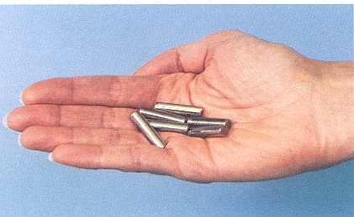
Cobalt - 60
Cobalt-60 pencils emit gamma radiation - this energy is harnessed to eliminate pathogens and microbes
Cobalt-60:
- A solid metal
- Non-fissionable
- Non-soluble
- Non-dispersible
- Non-flammable
- Long half life
- Large quantities per container
- Sources and containers licensed
- 5.25 year half-life

Slide 4
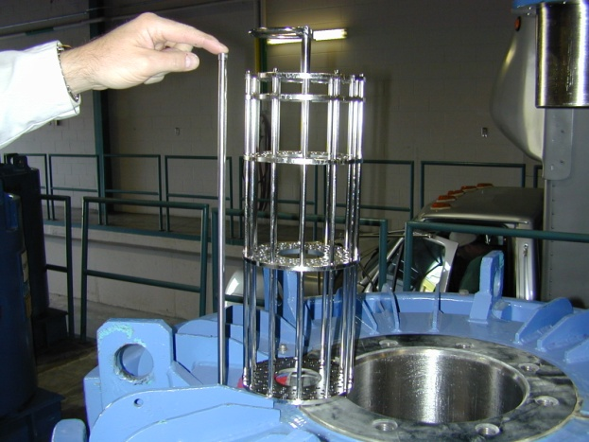
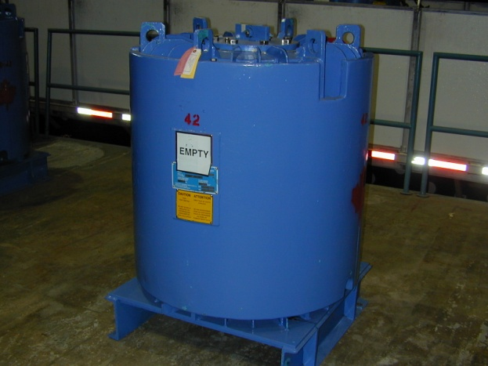
Cobalt- 60 Sources

Slide 5
Importance of Cobalt - 60 Sources
Cobalt - 60 sources are used to sterilize approximately 45% of all single-use medical supplies in the world
An estimated 80% of all surgical gloves are sterilized with Cobalt- 60
Certain products can only be sterilized with Cobalt - 60
Many products are optimally sterilized with Cobalt - 60
Sterilization of lab ware necessary for drug development and delivery
Enhancement of food safety and preservation (spices, fruit, vegetables, seafood, etc.)
Increase in sterilization demand due to an aging population, greater access to health care and increased risk of contamination of foodstuffs with disease causing bacteria
Sterilization is a critical process in the medical products manufacturing industry
Notes:
Products that can only be sterilized with Cobalt 60:
Biological materials such as tissue for transplant, plasma, serum; alcohol swabs, sealed medical devices used for blood collection, endoscopic procedures, and for use with certain catheters
Other examples of products sterilized with Cobalt 60:
Astronaut Food Packages
Baby Pacifiers and Baby Bottles
Bandages
Beakers
Food
Contact Lens, saline solution
Cosmetics
Implants
Intravenous sets
Surgical gowns, kits, drapes
Suture removal trays and sutures
Tubing and tube connectors
Dressings and dressing pads
Drainage Systems

Slide 6
F-168: Type B(U) Package
Type B(U) Package:
Large dimensions, weight and radioisotope holding capacity
Cobalt-60 to sterilization facilities:
- ports for export to overseas destinations
- road/ocean shipments for sterilization
Notes:
Safety and security is critically important to Nordion
Cobalt-60 is manufactured and transported according to updated stringent standards and new security requirements. Multiple administrative controls and engineering controls to assure safety of cobalt-60 transport. Supply chain knowledge = customers, suppliers, carriers, etc.
As the leading global cobalt-60 supplier, Nordion pursues global solutions. It is working closely with suppliers, customers and regulators to ensure that its cobalt-handling processes remain among the safest and most secure in the industry
We seek practical and effective requirements for safety and security

Slide 7
F-168 Package: Layers of Protection
Steel-covered insulated fire shields for thermal protection
Steel fins dissipate heat during normal conditions of transport and provide impact protection
11 inches (270 mm) of lead shielding, encased in steel for radiation protection
Cage containing double-encapsulated sealed sources
Weight: 5,445 kg (12,000 lbs)
Notes:
Type B(U) F-168 Package: 7400 TBq (200 kCi) in Special Form C-188 Capsule.
Cavity size is fixed for the standard sources.

Slide 8
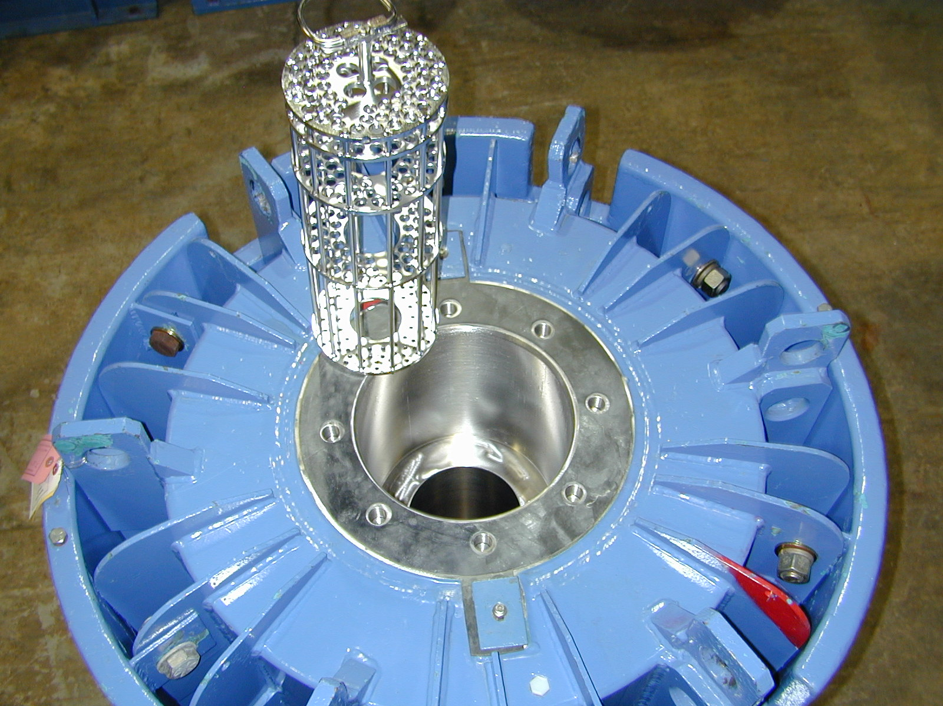
F-168 Container Design – Shielding
Notes:
Sealed source test must meet tests as prescribed in 10 CFR 36, ANSI N43.6 and IAEA TSR 1.
After all tests are completed, the source must still retain its leak tightness in order to be certified.
Drop Test: 9 meter (29.5 ft) drop onto an unyielding target
Percussion Test: A 1.4 kg (3 lbs) mild steel bar is dropped onto the source from a height of 1 meter (3.3 ft). Source is placed on a sheet of lead
Bending Test: 1.4 kg (3 lbs) mild steel bar is dropped onto the source from a height of 1 meter (3.3 ft). The source is held at one end.
Heat Test: Source is heated to 800°C (1472°F) for 10 minutes
Sealed cobalt-60 sources:
- Pencil: ~1 cm in diameter and 450 mm in length)
- Typically 370 TBq (10 kCi) of cobalt-60.
Cobalt slugs are double-encapsulated in stainless steel tubes

Slide 9
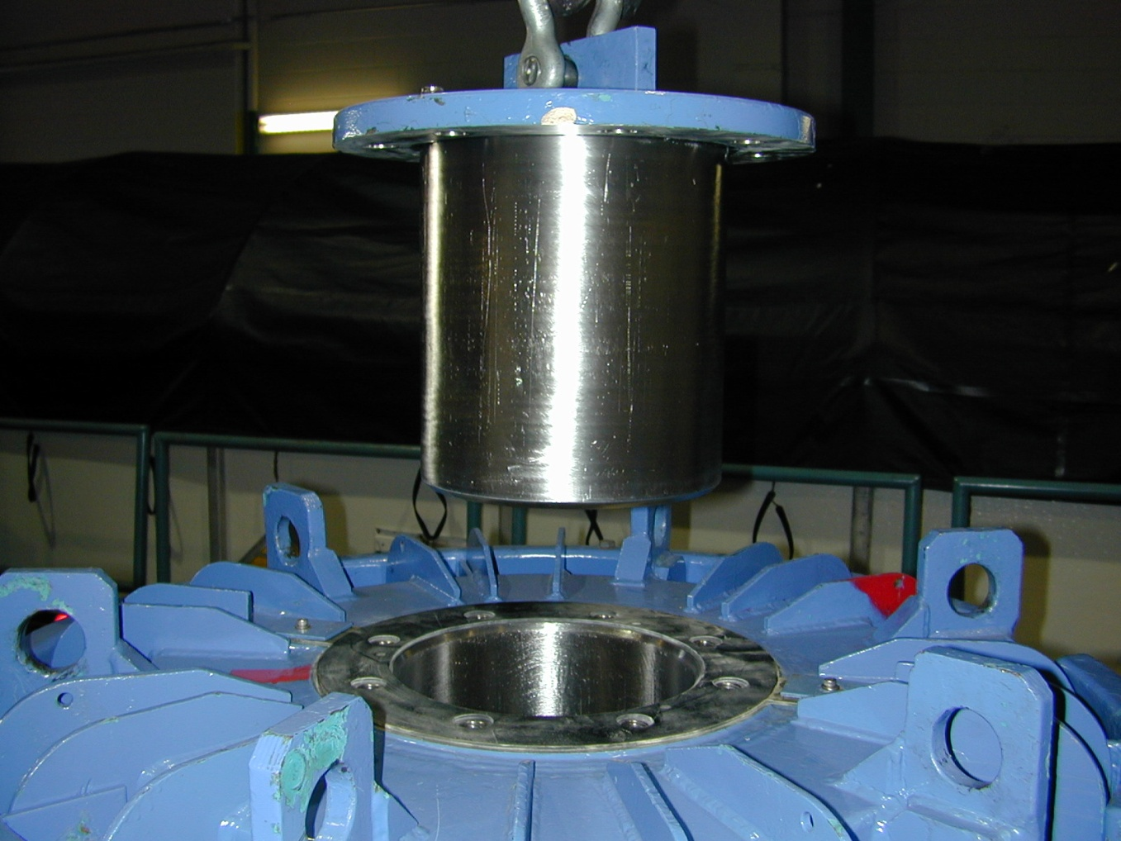
F-168 Container Design - Plug
Notes:
Sealed source test must meet tests as prescribed in 10 CFR 36, ANSI N43.6 and IAEA TSR 1.
After all tests are completed, the source must still retain its leak tightness in order to be certified.
Drop Test: 9 meter (29.5 ft) drop onto an unyielding target
Percussion Test: A 1.4 kg (3 lbs) mild steel bar is dropped onto the source from a height of 1 meter (3.3 ft). Source is placed on a sheet of lead
Bending Test: 1.4 kg (3 lbs) mild steel bar is dropped onto the source from a height of 1 meter (3.3 ft). The source is held at one end.
Heat Test: Source is heated to 800°C (1472°F) for 10 minutes
Sealed cobalt-60 sources:
- Pencil: ~1 cm in diameter and 450 mm in length)
- Typically 370 TBq (10 kCi) of cobalt-60.
Cobalt slugs are double-encapsulated in stainless steel tubes

Slide 10
Type B Package Testing
Several tests are required for licensing a Type B package
- 9 meter drop test
- Pin drop test
- Thermal test
No loss of radioactive material is allowed following container or source testing

Slide 11
Other Package Tests
Ship-to-ship collisions and on-board fires were not more severe than IAEA tests – IAEA simulated tests.
Collision against a hard wall with a transportation cask at a speed of 80 mph (~130 km/hr) – U.S. test.
Locomotive collision with cask at a speed of 100 mph (~160 km/hr) – U.K. test.
These extra-regulatory tests show that the IAEA test for demonstrating the package’s ability to withstand the accident conditions of transport are equivalent to or more robust than actual and simulated accident scenarios.
Notes:
Ship collisions result in the ship structure absorbing the collision force, not the container. Investigations also taken to examine ship-to-ship collisions and onboard fires. It has been concluded that these simulated tests were NOT more severe that the International Atomic Energy Agency (IAEA) tests. [Source: IAEA-CN-101/57; IAEA-CN-101/59]
Containers have been burned in a pool of aviation fuel for 90 minutes at temperatures of more than 2,000 F without rupturing. [Source: Nuclear Energy Institute (NEI) Fact Sheet, August 2004]
Canadian Nuclear Safety Commission (CNSC) tested an aircraft flight data recorder (FDR, an airplane black box) and type C packages. Based on employing the same mechanical tests (ie, 9m drop test, crush test), results indicate that a FDR may not survive the type C requirements and type C would likely survive the FDR crash survival testing requirements. [2004]
[Sources: “Severity, probability and risk of accidents during maritime transport of radioactive material”, International Atomic Energy Agency (IAEA), July 2001; and, International Conference on the Safety of Transport of Radioactive Material, Contributed Papers, July 2003]

Slide 12
Sea Freight Container Handling
Containers must be able to withstand worst-case potential accident conditions

Slide 13
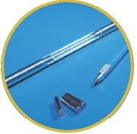
Package Licensing
F-168 packages licensed by Canadian Nuclear Safety Commission and other competent authorities (NRC, DOT, etc.)
Designed to contain large quantities of radioactive material and must meet the Accident Conditions of Transport standard
Sealed source pencils: approx. 0.5” diameter x 18” length
Container: approx. 45” diameter x 62” height (not incl. shipping skid)
Notes:
Metric:
Sealed source pencils: ~1 cm diameter x 450 mm length
Container: 1140 mm diameter x 1575 mm height (not incl. shipping skid)
1 pencil = ~10,000 curies (10kCi or 370 TBq)

Slide 14
Regulatory Control
All aspects of Cobalt - 60 source and container design, production, facility, carrier and transportation are highly regulated and licenced
IAEA Code of Conduct and Import / Export Controls in place globally
Highly trained, validated and licenced supply chain with specialist knowledge in handling and carriage of Cobalt -60
Route controls and approval
Nordion support throughout process

Slide 15
Sea Freight Shipping Container Preparation
Proper Blocking and Bracing is designed by a licensed Freight Handler under contract with Nordion.
This system is designed utilizing input from IMO standards and engineering calculations based on internationally accepted standards.
This container preparation is to be left in place for return shipments of Class 7 material
F-168 Cobalt Container
F-168 lower shipping skid
Blocking and Bracing (Treated Wood
and Nylon Straps)

Slide 16
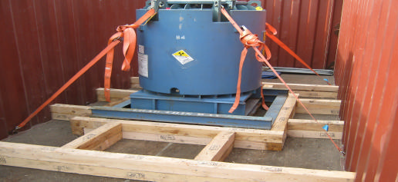
Typical Block and Brace for 1 x F-168

Slide 17
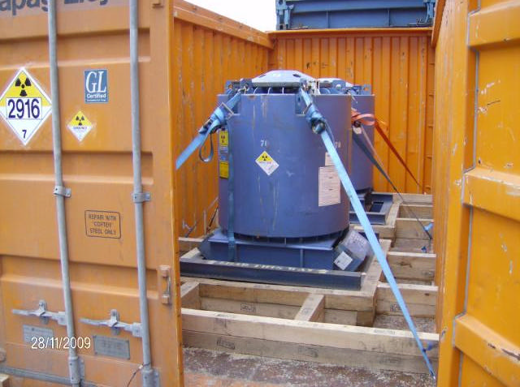
2 F-168 Containers Blocked and Braced in Seafreight Container
2 F-168 Packages are prepared, blocked and braced for shipment in a sea freight container by trained and licensed freight handlers in Canada
This preparation is not disturbed and left in place after cobalt loading for return shipment to Canada

Slide 18
Shipping Experience
Nordion ships over 500 radioactive material shipments internationally per year in Type B(U) packages. Many of these shipments include both outbound and return of radioisotopes
“Over several decades of transport, there has never been an in-transit accident with serious human health, economic or environmental consequences attributable to the radioactive nature of the goods”
IAEA International Conference on the Safety of Transport of Radioactive Material, 2003

Slide 19
Port of Singapore Experience
Shipping Cobalt - 60 to and through Port of Singapore for almost 27 years
Approximately 20 shipments / year on average through Port
0 denials in this history – impressive record and testament to Port and working processes
APL carrier and APL feeder vessels are primary for Nordion Co-60 shipments with excellent service and customer support
Countries shipped to which transit through Port of Singapore :
- China - Malaysia - Thailand
- Vietnam - Sri Lanka - Indonesia
- Philippines - Singapore
Notes:
APL arranges all transshipment requirements at Singapore including applying and obtaining the necessary transshipment permit with Singapore Authorities and including carrying the extra risks and liabilities – all at no additional cost to Nordion.
APL is the only carrier providing this service, whereas all other shipping lines currently carrying Co-60 shipments do not get involved in any transshipments of Class 7 whatsoever ( i.e. ACL / Hapag Lloyd / Hamburg Sued / Zim Lines/ ARRC / CSAL).
This APL service has assisted Nordion with obtaining a through ocean bills of lading from U.S.Load Port to ultimate discharge port , which is important for shipments covered under L/C. Cargo security and safety is also ensured by shipment remaining in the same ISO container from place of loading at Montreal to place of unloading at consignee’s facility.
It cannot be guaranteed that second carriers will accept another shipping line’s equipment ( and first carrier may also not allow their own equipment to be handed over to another carrier ) , which of course would result in either destuffing and transloading at one point or working with S/O equipment ( i.e. leased OT equipment, if accepted by all carriers ).
While APL’s feeder connections out of Singapore have worked very well considering the nature of the cargo, I realize however that at present, there are some delays in connecting with feeders due to feeders not accepting IMO 7 per se or not accepting IMO 7 from another carrier, as per alliance contracts signed between the different carriers co-loading on each other’s vessels.
Singapore is an important hub for many transshipments and considering the large worldwide movements of Natural Uranium shipments -(all volume business) which perhaps will all be discussed at the upcoming WNA meeting, the Port of Singapore will probably handle more Class 7 cargoes in the future.
While current pending shipment to Vietnam is already being verified by Consignee’s forwarders in terms of connecting with a feeder service from Singapore ( due to APL’s alliance partner not accepting IMO 7 from APL), perhaps a Singapore agent will need to be involved in any future shipments.
Experiencing problems with APL’s contract feeders and independent arrangements with outside feeders have to be made.

Slide 20
Transportation Issues
Timely receipt of Port approvals
Port of Singapore is central to many of the Asia Pacific countries shipped to
Excellent Port knowledge and capability, with significant history and positive relationship
APL primary carrier into Singapore and APL Feeder vessels out to other “local” Ports (i.e. Shanghai, Port Kelang, Colombo, Bangkok, Manila, Jakarta, Ho Chi Minh City)
Increasingly busy with new requirement to have Co-60 sit at Port for 72 hours from time of carrier arrival to feeder departure to final destination
Notes:
Shipments cannot proceed to the departure ports until all vessel and port approvals have been received by the carrier.
Port approvals required 24-36 hours prior to departure from Nordion
Often shipments are waiting in Montreal and at times have been loaded to trucks while waiting for the written port approval.
Regarding Viet Nam… the issue is also there is only one port accepting Class 7 and ironically there are no Class 7 carriers going into that port. We could perhaps get a feeder to other ports however the port won’t allow Class 7 to discharge.
Singapore 72 hour requirement : has an adverse impact on our delivery service level in that it minimizes the available sailing dates for us. Instead of taking advantage of weekly sailings from San Pedro, we may only be able to utilize a sailing every 2 or 3 weeks to coordinate with the feeder company schedule out of Singapore.

Slide 21
Transportation Issues
Very limited number of feeder vessels having Class 7 carriage capability from Port of Singapore (makes scheduling and logistics very challenging and restrictive)
Restrictive alliance contracts between different carriers who co-load each other’s vessels (further restricts ability to move Co-60 in the Asia – Pacific region)
Limited number of Ports in many countries which are able / willing to handle receipt of Class 7 products (China – Port of Shanghai; Vietnam – Port of Ho Chi Minh City / VICT (Vietnam International Container Terminal))
Limited number of Ports allowing transshipment and even in transit shipment of Class 7 products through them, thus restricting routings and available shipping options
IMPACT : NO feeder vessel service accepting Class 7 to Vietnam’s HCM/VICT Terminal. More feeder vessel acceptances of Class 7 or more Ports accepting Class 7 would resolve this critical issue
Notes:
Laurentide feels that in general we cannot compare current Singapore situation and feeder vessel connections with previous shipments. The port of Singapore is not issue at all
- Availability of more feeder vessels that do not call on ports that deny ‘in transit’ ie China ports. To Shanghai there is currently a feeder only every 3-4 weeks that is suitable for Class 7 due to port rotations.
issues are the signed agreements between feeder vessels/owners/operators and the charter agreement signed between main lines and feeder operators – Class 1 and Class 7 are usually excluded in the charter agreements, so carriers do not accept these classes from their alliance partners, and it seems more and more alliances are formed between the various shipping lines for economic reasons. At the present time shipments have to be scheduled based on vessel availability and not necessarily on preferred arrival dates by the consignee… Laurentide is wondering if there is any flexibility.

Slide 22
Actions Going Forward
Increase the number of feeder vessels capable and willing to move Co-60 from Port of Singapore to other Ports in the Asia Pacific region
Increase the number of Ports in countries which are willing and able to receive and process Co-60 for transit within that country to end users of Co-60
Increased integration of Asia – Pacific countries with IAEA National Focal Points and Regional Coordinators in the Asia – Pacific Regional Network

Slide 23
Thank-you
Questions ?

